Slide 1

AARCHANA L NICHANI
Final Project

Slide 2

PROJECT TITLE
Genie: Your AI-Powered Virtual Companion

Slide 3


AGENDA
Introduction to Genie
Problem Statement
Project Overview
End Users
Solution and Proposition
Key Features
Modeling Approach
Results and Impact
3/21/2024 Annual Review

Slide 4

PROBLEM STATEMENT
In today's fast-paced world, individuals often struggle to manage various tasks efficiently due to time constraints and information overload.
There is a need for a virtual assistant that can streamline daily activities, provide relevant information, and offer personalized assistance.

Slide 5

PROJECT OVERVIEW
Genie is an AI-powered virtual companion designed to assist users with a wide range of tasks, including answering questions, providing information, managing schedules, and more.
It leverages natural language processing (NLP) and machine learning algorithms to understand user queries and respond intelligently.

Slide 6

WHO ARE THE END USERS?
Busy Professionals
Students and Academics
Home Users
Entrepreneurs and Small Business Owners
Elderly and Individuals with Disabilities

Slide 7

YOUR SOLUTION AND ITS VALUE PROPOSITION
Genie offers a comprehensive solution to address the challenges faced by users in managing tasks and accessing information.
Its key proposition lies in its ability to understand natural language queries, provide accurate and timely responses, and adapt to user preferences over time.

Slide 8

THE WOW IN YOUR SOLUTION
Seamless voice interaction: Users can interact with Genie using natural language commands and receive spoken responses.
Personalized assistance: Genie learns from user interactions and preferences to provide tailored recommendations and assistance.
Integration with OpenAI: Genie leverages cutting-edge AI models from OpenAI to offer intelligent responses and insights.
Automation: Genie automates routine tasks such as sending emails, checking the weather, and playing music, enhancing user productivity.
3/21/2024 Annual Review

Slide 9
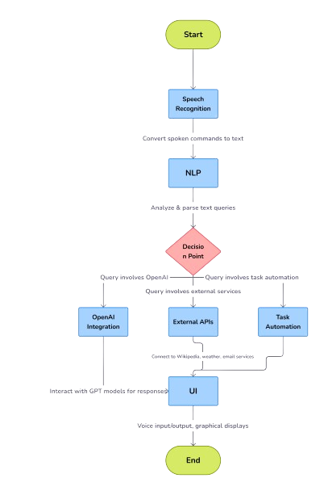
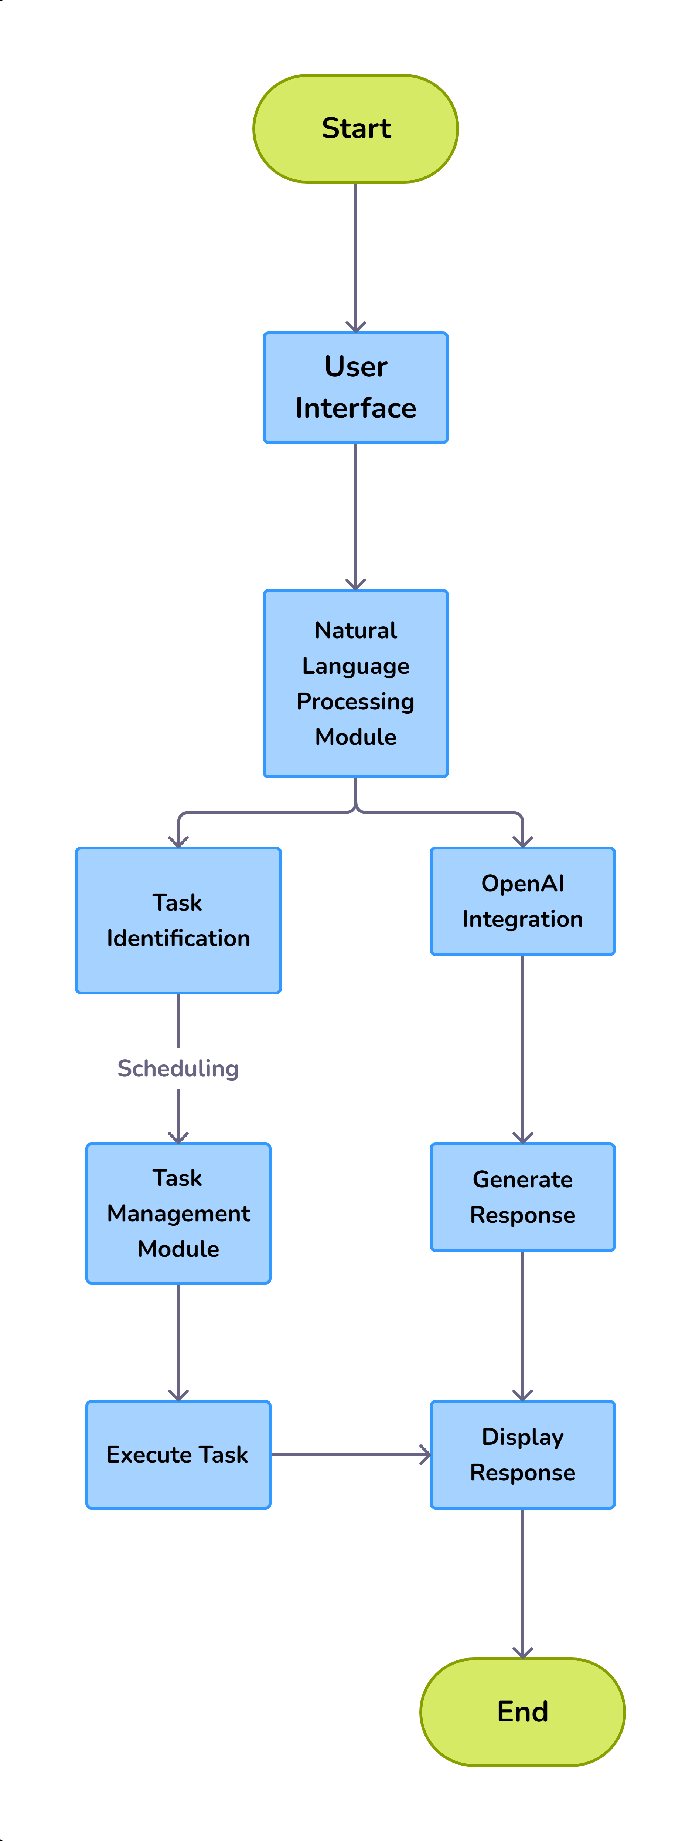

MODELLING

Slide 10
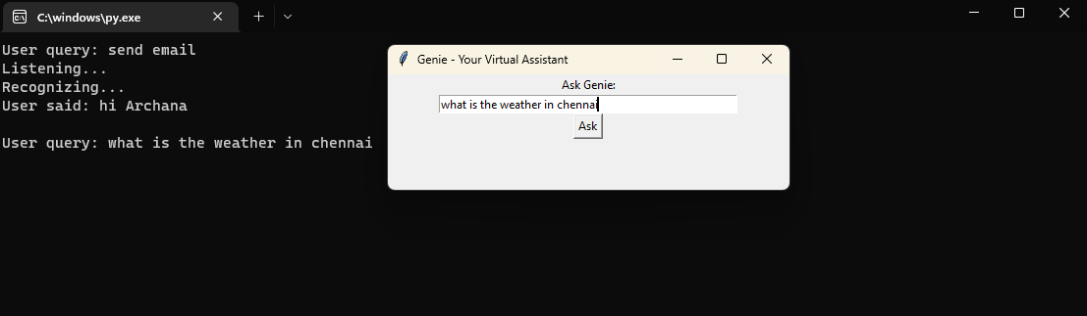
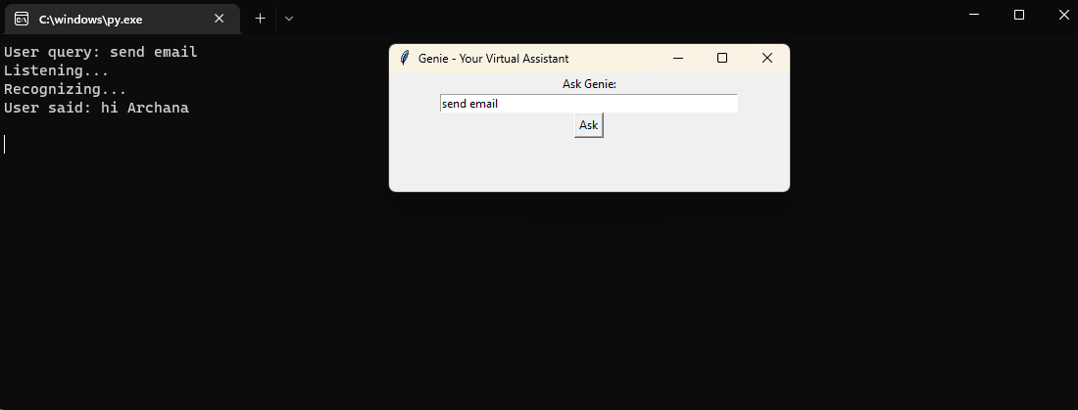
RESULTS
Demo Link

Slide 11
